Slide 1
FINAL PROJECT

Slide 2
Subject
The traffic stops that took place in Charlotte, N.C. in 2016 and 2017
Charlotte is the largest city in North Carolina
It’s the 17th largest city in the U.S. with a population of 859,035 (2017)

Slide 3
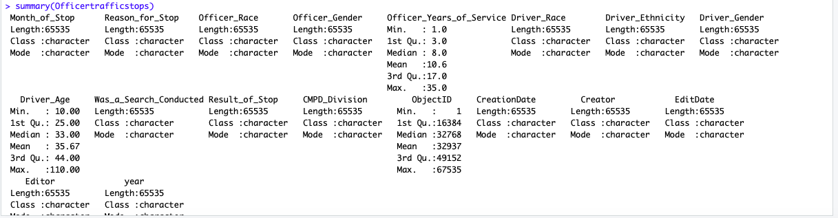
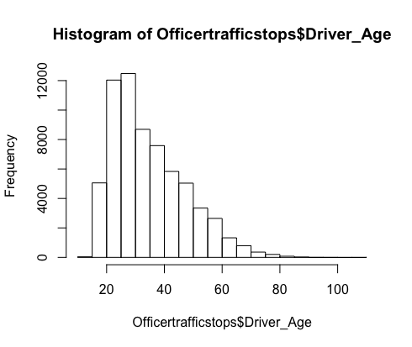
Overview of the data
The summary helps see the mean of the numerical values
The histogram of driver age visually demonstrates how the data is distributed
Notes:
From the histogram most of the drivers who got stopped at a traffic stop were between the ages of 20-30 years of age

Slide 4
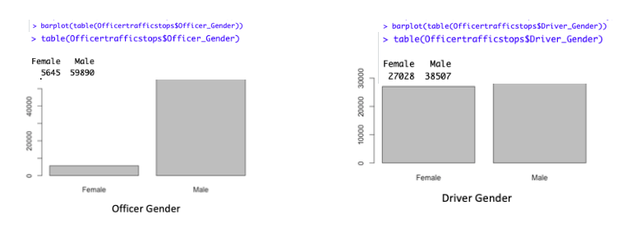
Overview of the data
Notes:
For the categorical values, bar graphs are used to understand the data. I wanted to compare the driver age to officer age and driver race to officer race. When looking at the driver gender bar graph, men take the lead as the gender who gets stopped as well as male officer who conduct the stops

Slide 5
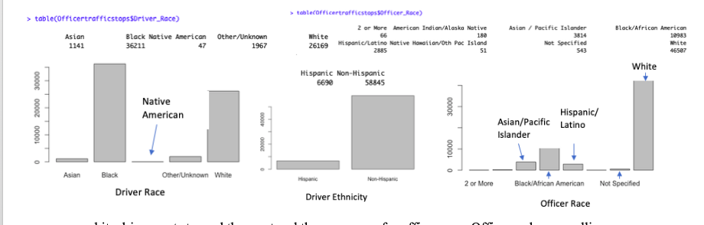
Overview of the data
Notes:
Concerning race of officers and drivers the data provided different options for both, but I wanted to analyze 4: Asian, Black/African American, White, and Hispanic. From the bar graphs, I can observe black and white drivers get stopped the most and the same goes for officer race. Officers who are pulling over these drivers are predominately white or black.

Slide 6
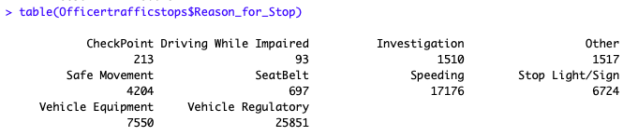
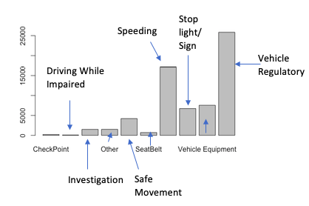
Overview of the data
Notes:
For the reason of stops the data provided 10 different reasons. The top reason for stops is vehicle regulatory with 25,851 stops, the second highest is speeding with 17,176 stops and third highest is vehicle equipment with 7,750 stops

Slide 7
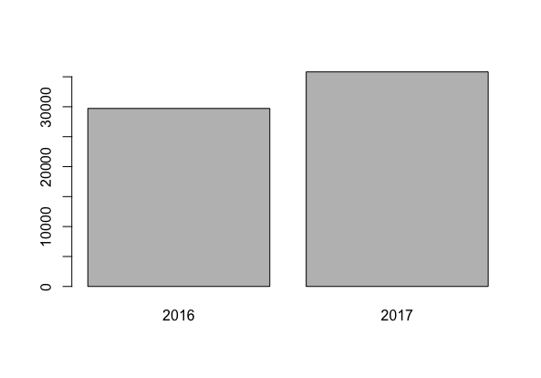
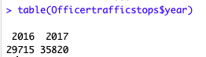
Overview of the data
Notes:
The data gives us two years of traffic stops and I wanted to see in a year how many traffic stops were conducted and if there was an increase and decrease over the two years. The table function in R numerically demonstrates that 2017 there were 35,820 stops and in 2016 there were 29,715 stops. There was definetly an increase in traffic stops from 2016 to 2017.

Slide 8
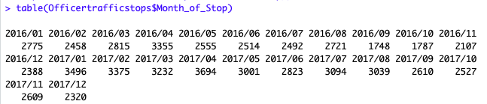
Overview of the data
Notes:
I decided to take a look at the months in the year. Both years in April show significance stops compared to the other months. The months that had the least September in 2016 and December in 2017.

Slide 9
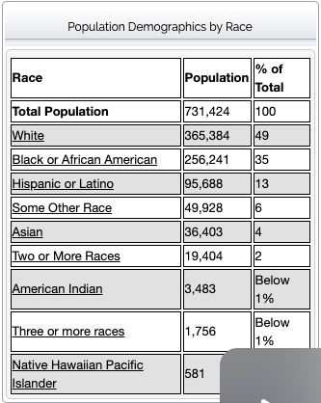
Outside information
White citizens in Charlotte, NC are 7 % likely to get stopped
African Americans are 14 % likely to get stopped
Hispanics are 7 % likely to get stopped
Asians are 3 % likely to get stopped
Notes:
The population by race of Charlotte for 2019 was composed of 49 percent White, 35 percent African American, 13 percent Hispanic or Latino and 4 percent Asian. I did some calculations using the totals I got from race in the dataset out of the population.

Slide 10
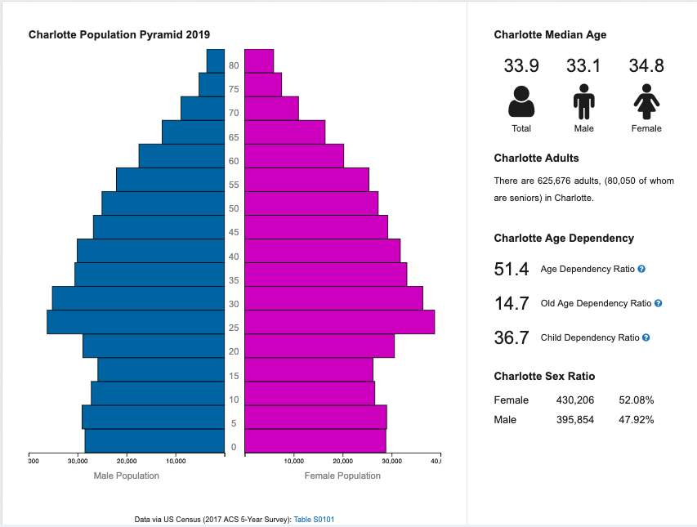
Outside information
Females are 6.2 % likely to get stopped by an officer
Males are 9.7 % likely to get stopped by an officer
Dataset median age is same as Charlotte median age of 33
Notes:
- Females make 52 percent of Charlotte’s population while male’s make 47 percent. After doing some calculations with the data I discovered that females are 6.2 percent likely to get stopped by an officer while males are 9.7 percent likely to get stopped by an officer.
- Even though there is a significant percentage of less male than female in the population, males are more likely to get stopped than females.
- I also wanted to compare the median age that the dataset gave and it matches the Charlotte median age of 33.
- This gives me an indication that my date depicts a good sample size of the population.

Slide 11
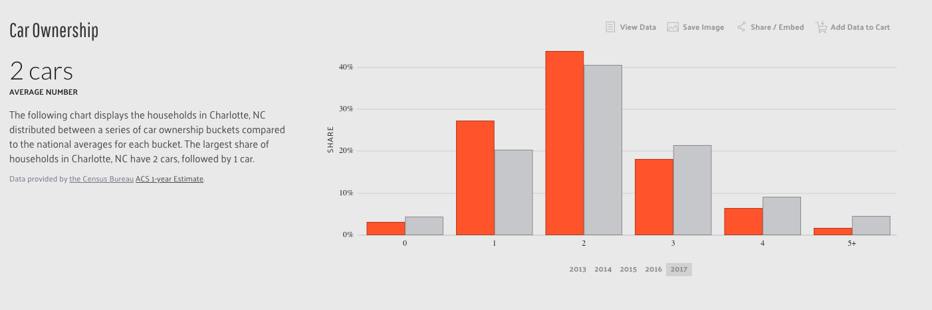
Outside information
Notes:
I wanted to find information on how many drivers or which genders drove or owned a car, but the closest I could get was information on car ownership. A household in Charlotte, NC has 2 cars, followed by 1 car

Slide 12
Question to investigate with this data
Can I predict why certain ages, genders, and races are getting pulled over?
Null hypothesis = Officers pull over all ages, gender, and races for similar reasons
Alternative = Officers tend to pull over certain ages, genders or races for different reasons

Slide 13
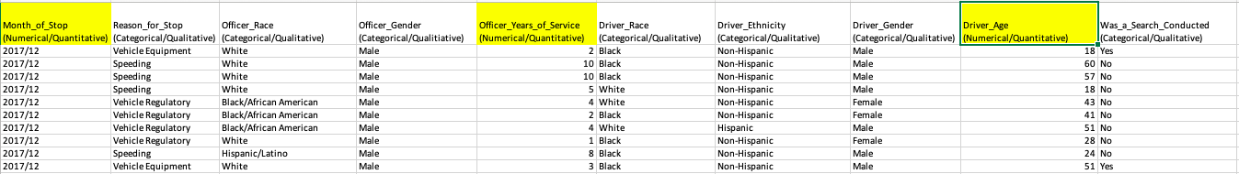
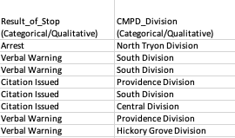
Snapshot of the data
Notes:
The values I used for the dataset is reason of stop, driver race, driver gender and driver age. Reason of stop, drive race and drive gender are all categorical/qualitative, but driver age is the only value that is numerical/continuous.

Slide 14
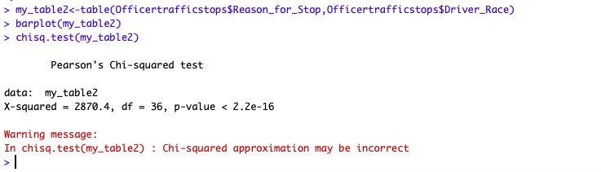
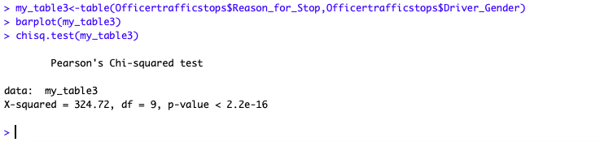
Statistical test
Performed a chi-square for reason of stop to driver race and reason of stop, and reason of stop to driver gender
REJECT
Null hypothesis = Officers pull over all ages, gender, and races for similar reasons
Notes:
The result of both chi-square demonstrated that the p-value is less than 0.05 which means that I have to reject the null. There are different reasons officers tend to pull over by age, gender, or race.

Slide 15
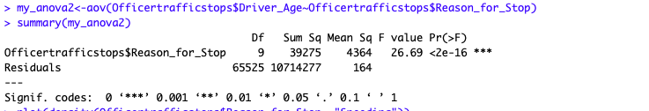
Statistical test
Performed an anova for reason of stop to driver age
P value is less than 0.05
Notes:
The P value is less than 0.05 which means there is a difference between some of the means that are statistically significant. Because we don’t know which group is statistically significant running a post hoc such as a tukey would come in handy.

Slide 16
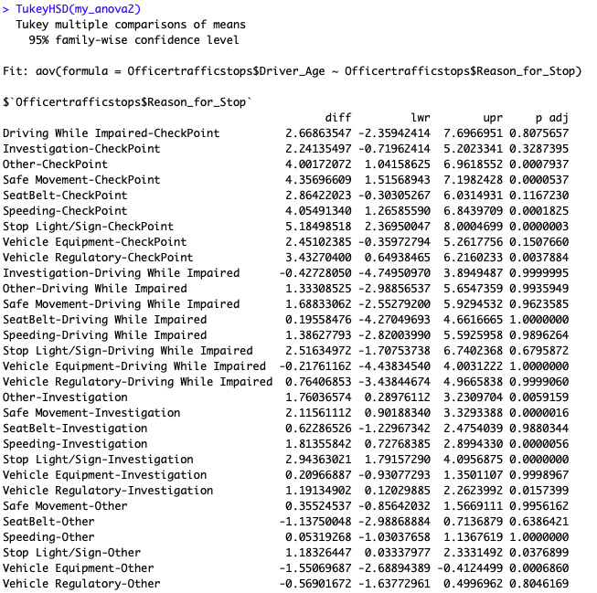
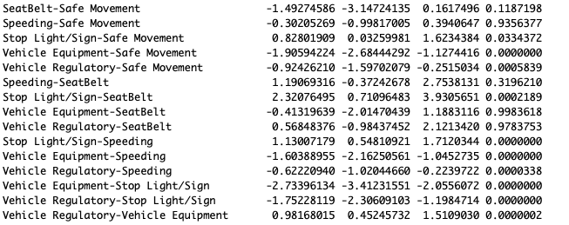
Statistical test
P value is less than 0.05
Tukey – Post Hoc test
The test demonstrates a stronger relationship for age and reason for stop
Notes:
The one thing to notice in the tukey is the comparison which has the most significance. It will display as the most negative difference.
Looking at the test I can see that Vehicle equipment – stop light/sign is the most significant with -2.73 and the second significant is Vehicle regulatory – stop light/sign with -1.75.
The test demonstrates a stronger relationship for age and reason for stop

Slide 17
Answer to Question with this data
Can I predict why certain ages, genders, and races are getting pulled over?
Null hypothesis = Officers pull over all ages, gender, and races for similar reasons
Alternative = Officers tend to pull over certain ages, genders or races for different reasons
No
With gender and race officers tend to have different reasons for pulling over because I had to reject the null
With age there is a strong relationship for the reason an officer pulls over

